Slide 1

VAdata and CSVs:
Part Two – The Import Tool
VAdata: Virginia’s Sexual and Domestic Violence Data Collection System

Slide 2
What is a CSV anyhow?
  A Comma Separated Values (CSV) file is a plain text file that contains a list of data points. These types of files are often used for exchanging data between different applications.
  The idea is that you can export complex data from one application to a CSV file, and then import the data in that CSV file into another application or program. The resulting data is “human-readable” and can be easily viewed using a text editor like Notepad or a spreadsheet program like Microsoft Excel.

Slide 3
Why Are We Doing This?
We recognize many agencies use more than one database to track their information
We want to make it easier to share data between systems
We want agencies to have a way to back up all of their client data
Added control over agency’s data

Slide 4
What Kind of Data Can be Imported?
The system is current set up to import Hotline, Advocacy records and sheets, and Community Engagement forms.
It is important to note that you should only use the import tool for new data. This means you should only be adding either brand new records or new sheets to existing records.
To edit existing data, you will need to go directly into those records in Vadata to make changes.

Slide 5
How Do We Get Started?
First, your agency will need to become familiar with using the import tool on the Sandbox site. This test site looks and functions just like the live site.
In the Sandbox, you will be able to test data uploads without fear that it will mess up any live data currently on the system. To gain access to the Sandbox site, contact Tamara at tmason@vsdvalliance.org to get you started!
Once you’re set up in the Sandbox, the following slides will let you know what to do. You can also watch the CSV Import Tool recorded training found on the Training Modules and Webinars page of Vadata.

Slide 6
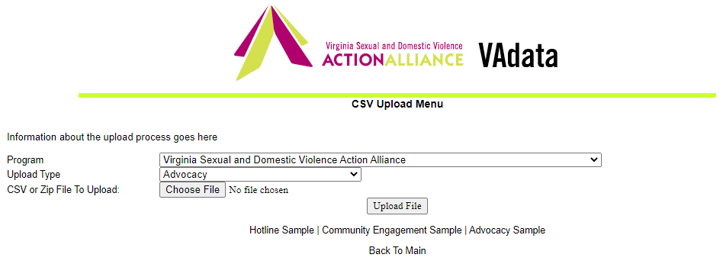
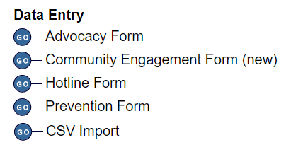
How Do I Import My System’s Data?
You will need to make sure your system’s data is set up in a way that VAdata can read and understand it.
The best way to do this is to download the Sample CSV files on the Sandbox site so you will know exactly how the data should be formatted.
To do this, you will click on “CSV Import” in the Vadata Tools menu, then select one of the sample files to download.

Slide 7
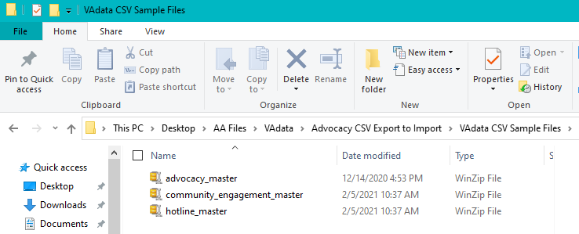
The sample files will download as Zip files, which will need to be “unzipped”. Most PCs running on current Windows software have a built-in file extractor, but WinZip can also be downloaded and used for free.
Your downloaded files will look like this until they are unzipped, revealing the csv spreadsheets

Slide 8
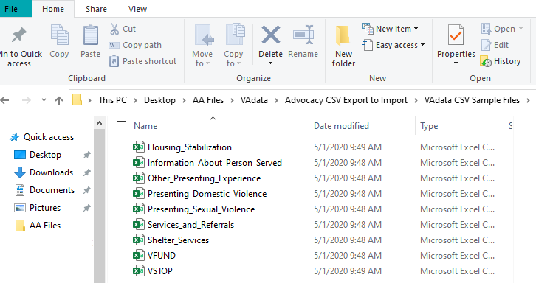
Once you have unzipped the files, you will see that each “sheet” of the VAdata forms is displayed as a separate spreadsheet in the file.
For the Hotline form, you will only see one spreadsheet.
For the Advocacy and Community Engagement forms, you will see a separate spreadsheet for each tab of the form.

Slide 9
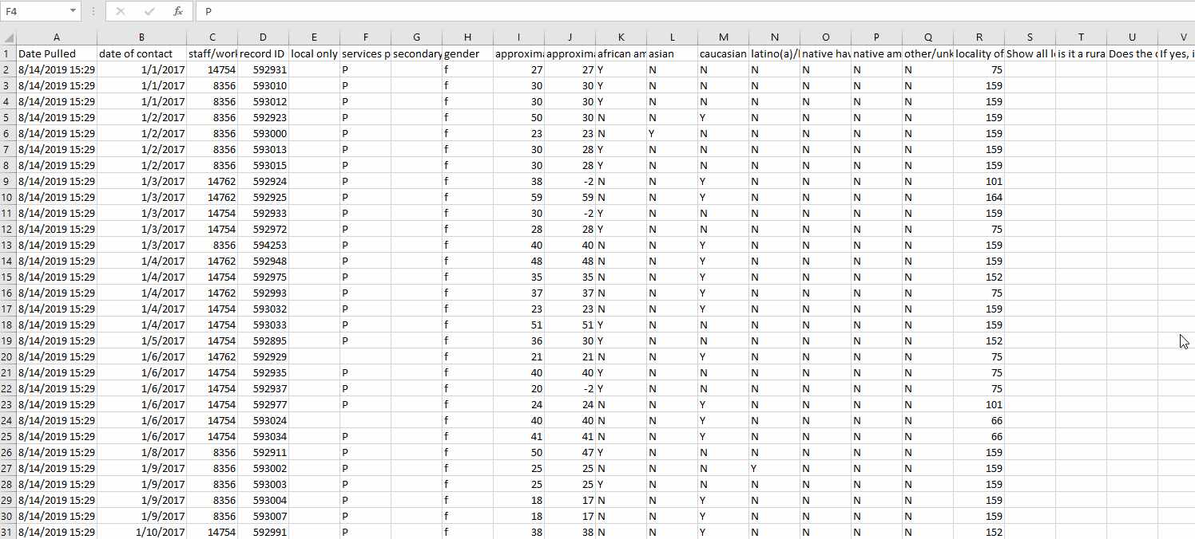
How will the Data be Displayed?
The sample files will be blank. When you’ve filled in all of your data, it will look something like this:

Slide 10
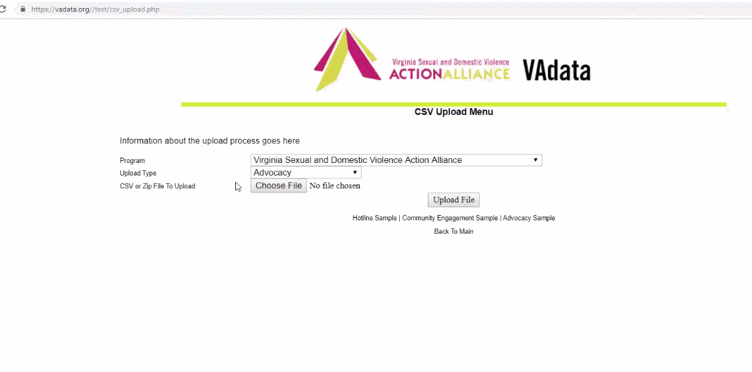
What are the Steps for the Upload?
The first step is uploading your data file. Your file can have as few as 1 row or as many as 10,000 (but please let us know if you are uploading 10,000 new records, as that may create lag with the system).

Slide 11
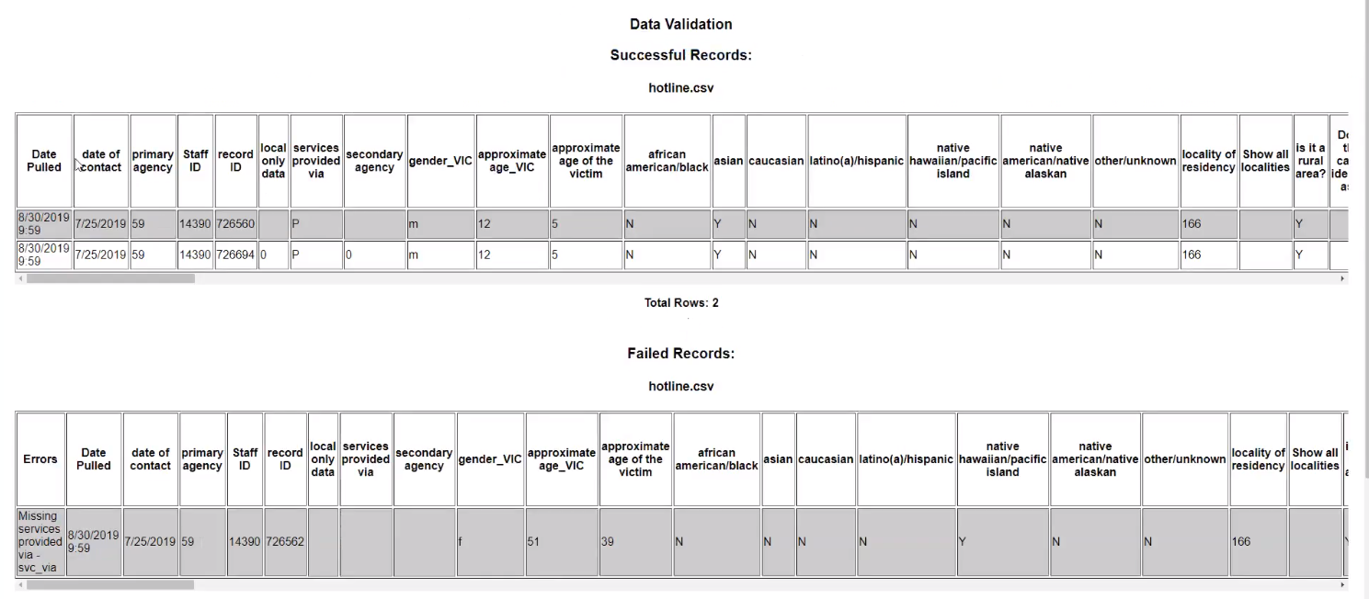
What are the Steps for the Upload?
Next, you will get to the data verification page that will validate the data you are preparing to upload. Rows from your tables will display as Successful Records and Failed Records.

Slide 12
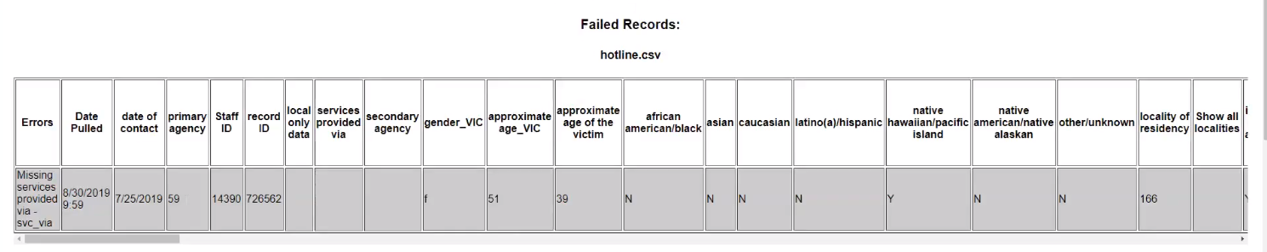
What are the Steps for the Upload?
Your Successful Records are ready for upload right away.
Failed Records are rows that either have missing required data or invalid values.
The very first column of the failed records section lists the errors to be corrected for each of the rows. You may have to scroll to the right to see the values on each row, under each column, as there are many columns on the form.

Slide 13
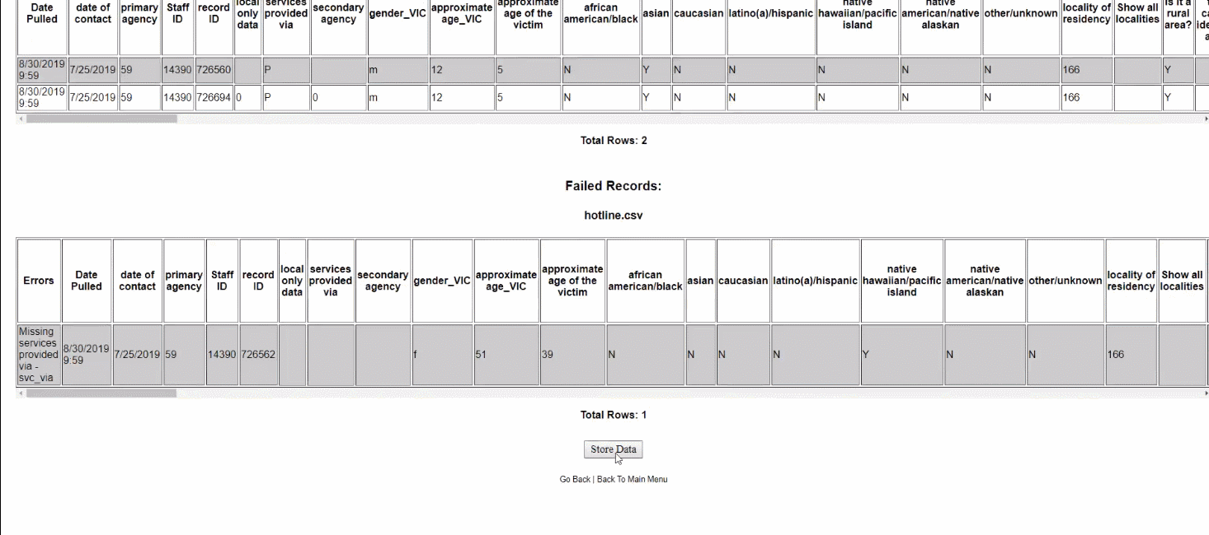
At this point, you can either choose to go back and fix any errors in the data, then upload a completely new file, OR
You can goa head and click “Store Data”. The system will then display “Upload Complete” with another list of successful records and the list of those that failed.

Slide 14
We are working to set up a system by which a developer can build a direct bridge from your system to VAdata.
This functionality will take some time to set up, but if you are interested in doing this, contact Tamara (tmason@vsdvalliance.org) and we can arrange a time for the VAdata programmer and your developer to talk “techie-to-techie” about this.
In the interim, we have developed some mapping guidance for those working to set up transfer files. This guidance will show the type of data required for each field.
  These guidance documents can be downloaded at:
  CSV Advocacy Form Mapping Guidance
  CSV Hotline Form Mapping Guidance

Slide 15

Help Options
You may see this symbol by several fields on the form:
Click on the symbol for more detailed information or requirements of the field.

Slide 16
HELP! VAdata’s not working.
If you think something is wrong with VAdata, please let us know! Give us a call at 804.377.0335 or email us at
vadataadmin@vsdvalliance.org
We don’t use VAdata every day in the same ways you do, so sometimes the only way that we know something is broken is when you tell us.
We also like to talk with you by phone when you have questions because we may need additional details about your concern in order to fix the issue.

Slide 17
How Can I Get Additional Help About Other Topics or Concerns?
The Action Alliance staff urge you to contact us whenever you have a question or a concern about VAdata, resources, advocacy, policy, training, funding, or anything else.
Staff can be reached at
804.377.0335
Or you can visit our website to send a message directly to staff members. Visit https://vsdvalliance.org/contact/.

